Slide 1
ADC & DAC

Slide 2

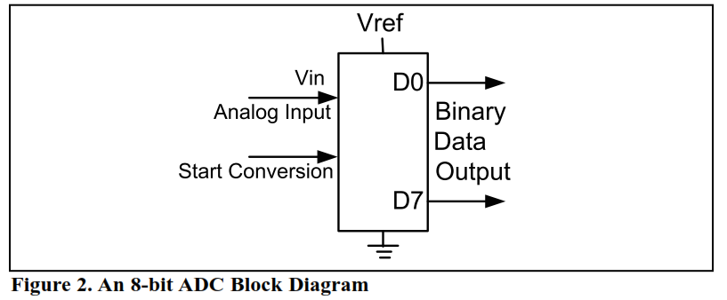
ADC

Slide 3

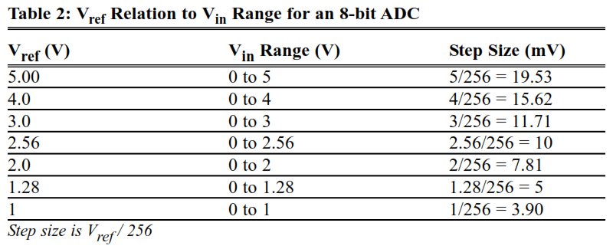
ADC Characteristics

Slide 4


ADC Output

Slide 5
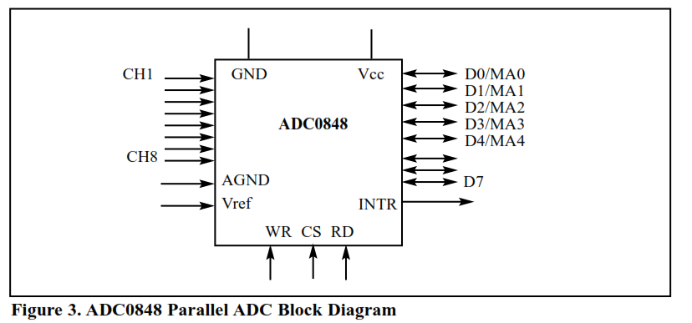
Parallel ADC

Slide 6
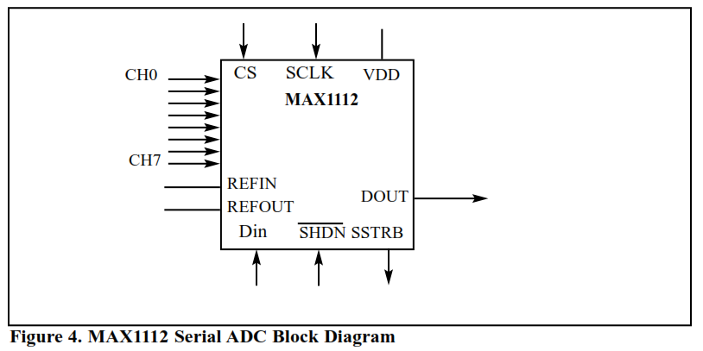
Serial ADC

Slide 7


Slide 8


Slide 9
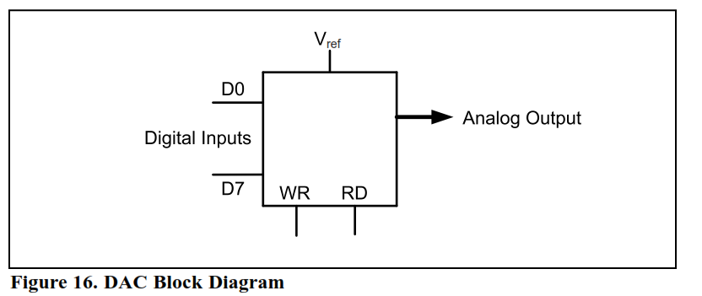
DAC

Slide 10

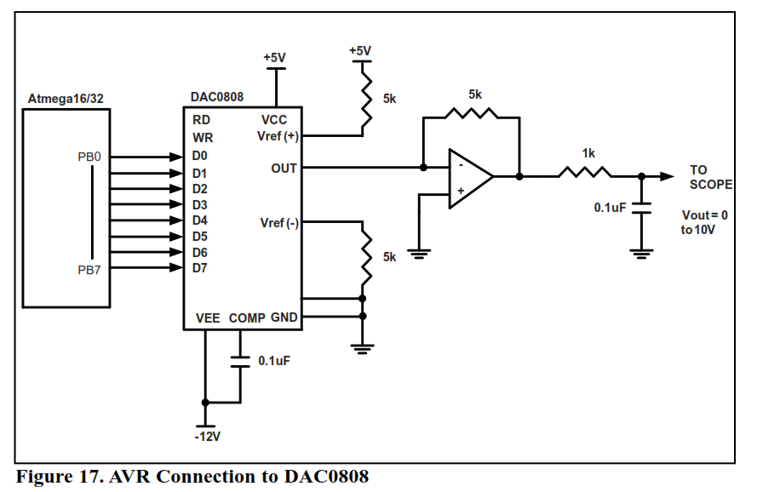

Slide 11
